Slide 1
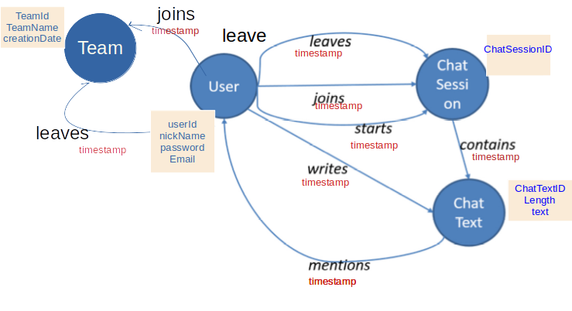
Questions
Briefly explain how you would use the graph to answer the following five questions?
Which teams are having more conversations?
A new node team node has been added to the original graph to answer this question.
ChatSession (conversation) is linked to team by user
A user joins a team and is associated to it since it leaves
user “starts” or joins a ChatSession
So we can answer to the question considering total chatSession for each user of each teams
Do users chat more (or less) before they leave a team?
Assumption : chatting more/less is related to the number of chatSessions a user starts / joins
Through the timestamp of the egde starts and joins of the user and chatsession we can measure the numenr of session over the time
The edge a user “leaves” a groups has also its timestamp and we can understand the user chatting behavior before and after the even
What are the dominant terms (words) used in a chat session within a specific time period?
Considering the timestamps of the edge “contains” we able capable to have all chaText in the specific period of time
these chatText are a documet vector and a it-tdf matrix could be build to provide the frequency of the terms
Which users are most active in a specific chat session?
In a specific session, each user writes chatText. The tot chatText for each user of the session provide the answer
How many chat sessions is a user participating in at the same time?
User and session are linked through 3 edges (starts , joins & leaves) each of them with a specific timestamp
In a time x, the number of chatSessions is the tot chatSession the user starts and joins excluding the sessions left
id | Property
team | teamID teamName creationDate
user | UserId nickName email Password playerCategory
chatSession | chatSessionID
chatText | chatTextID textLenght
SrcId | DstID | Property(E)
user | team | joins
user | team | leaves
user | chatSession | starts
user | chatSession | joins
user | chateSession | leaves
ChatSession | ChatText | contains
user | ChatText | writes
chatText | user | mentions

